Slide 1
DISTRIBUTED DATABASES
AND
CLIENT-SERVER ARCHITECHURES

Slide 2
CONTENTS .
Distributed Database Concepts
    Parallel Vs Distributed Technology
    Advantages
    Additional Functions
Distribution Database Design
    Data Fragmentation
    Data Replication
    Data Allocation
    Example

Slide 3
CONTENTS (cont..)
Types Of Distributed Database Systems
Query Processing in Distributed Database
    Data Transfer Costs
    Semijoin
    Query & Update Decomposition
Overview Of Concurrency Control & Recovery in Distributed Databases
    Concurrency Control Based on Distributed Copy of a Data Item
    Concurrency Control Based on Voting
    Distributed Recovery

Slide 4
CONTENTS (cont..)
Overview Of 3-Tier Client-Server Architecture
    Interaction between Application Server & Client Server
Distributed Database In ORACLE

Slide 5
DISTRIBUTED DATABASE CONCEPTS

Slide 6
DISTRIBUTED DATABASE CONCEPTS
Distributed Computing System
  Consists of a number of processing elements interconnected by a computer network that cooperate in processing certain tasks
Distributed Database
  Collection of logically interrelated databases over a computer network
Distributed DBMS
  Software system that manages a distributed DB

Slide 7
PARALLEL vs. DISTRIBUTED TECHNOLOGY
Parallel system architectures:
Shared Memory Architecture
  Multiple processors that share both secondary disk storage and primary memory
  Tightly coupled architecture
  Shared everything architecture
Shared Disk Architecture
  Multiple processors that share secondary disk storage but have their own primary memory
  Loosely coupled architecture

Slide 8
PARALLEL vs. DISTRIBUTED TECHNOLOGY (contd…)
Shared Nothing Architecture
  Multiple processors that have their own secondary disk storage and primary memory
  Processes communicate over a high speed interconnection network
  Symmetry or homogeneity of nodes
Distributed Technology
  Heterogeneity of hardware and operating system at every node

Slide 9
ADVANTAGE OF DISTRIBUTED DATABASES
Management of distributed data with different levels of transparency (This refers to the physical placement of data (files, relations, etc.) which is not known to the user (distribution transparency).
  Distribution or network transparency- Users do not have to worry about operational details of the network.
    Location transparency (refers to freedom of issuing command from any location without affecting its working).
    Naming transparency (allows access to any names object (files, relations, etc.) from any location).
  Replication transparency- allows to store copies of a data at multiple sites. This is done to minimize access time to the required data.
    User is unaware of the existence of multiple copies
  Fragmentation transparency-Allows to fragment a relation horizontally (create a subset of tuples of a relation) or vertically (create a subset of columns of a relation).
    Horizontal fragmentation
    Vertical fragmentation

Slide 10
ADVANTAGE OF DISTRIBUTED DATABASES (contd…)
Increased Reliability and Availability
  Reliability – Probability that a system is running at a given time
  Availability – Probability that a system is continuously available during a time interval
When the data and the DBMS software are distributed Over several sites ,one site may fail other sites continue to Operate. Only the data and the software that exist at
the failed site cannot be accessed. This improves both reliability and availability
Improved Performance
  Data Localization – A Distributed database management system fragments the database by keeping the data closer to where it is needed. Data Localization reduces the contention for CPU and I/O services and simultaneously reduces access delays involved in wide area networks.
Easier Expansion- In a Distributed environment , expansion of the system in terms of adding more data, increasing the database sizes or adding more processors is much more easier.

Slide 11
ADDITIONAL FUNCTIONS OF DDBs
Keeping track of data
  Ability to keep track of data distribution
Distributed query processing
  Ability to access remote sites and transmit queries
Distributed transaction management
  Ability to devise execution strategies for queries and transactions that access data from more than one site
  Synchronize access to distributed data
  Maintain integrity of the overall database

Slide 12
ADDITIONAL FUNCTIONS OF DDBs (contd…)
Replicated data management
  Ability to decide which copy of the replicated data item to access
  Maintain the consistency of copies of a replicated data item
Distributed database recovery
  Ability to recover from individual site crashes and failure of communication links

Slide 13
ADDITIONAL FUNCTIONS OF DDBs (contd…)
Security
  Proper management of security of the data
  Proper authorization/access privileges of users
Distributed directory (catalog) management
  Directory contains information about data in the database
  Directory may be global for the entire DDB or local for each site

Slide 14
DDBMS vs. CENTRALIZED SYSTEM
Multiple computers called sites and nodes
Sites connected by some type of communication network to transmit data and commands
Sites located in physical proximity connected via LANs
Sites geographically distributed over large distances connected via WANs

Slide 15
Distribution Database Design
DATA FRAGMENTATION, REPLICATION, AND ALLOCATION TECHNIQUES FOR DISTRIBUTED DATABASE DESIGN
Fragmentation: Breaking up the database into logical units called fragments and assigned for storage at various sites.
Data replication: The process of storing fragments in more than one site
Data Allocation: The process of assigning a particular fragment to a particular site in a distributed system.
The information concerning the data fragmentation, allocation and replication is stored in a global directory.

Slide 16
DATA FRAGMENTATION
Breaking up the database into logical units called fragments and assigned for storage at various sites.
Types of Fragmentation
  Horizontal Fragmentation
  Vertical Fragmentation
  Mixed (Hybrid) Fragmentation
Fragmentation Schema
  Definition of a set of fragments that include all attributes and tuples in the database
  The whole database can be reconstructed from the fragments

Slide 17
Horizontal fragmentation:
  It is a horizontal subset of a relation which contain those tuples which satisfy selection conditions.
  Consider the Employee relation with selection condition (DNO = 5). All tuples satisfy this condition will create a subset which will be a horizontal fragment of Employee relation.
  Horizontal fragmentation divides a relation horizontally by grouping rows to create subsets of tuples where each subset has a certain logical meaning.

Slide 18
HORIZONTAL FRAGMENTATION
Horizontal fragment is a subset of tuples in that relation
Tuples are specified by a condition on one or more attributes of the relation
Divides a relation horizontally by grouping rows to create subset of tuples
Derived Horizontal Fragmentation – partitioning a primary relation into secondary relations related to primary through a foreign key

Slide 19
Vertical fragmentation
  It is a subset of a relation which is created by a subset of columns. Thus a vertical fragment of a relation will contain values of selected columns. There is no selection condition used in vertical fragmentation.
  Consider the Employee relation. A vertical fragment can be created by keeping the values of Name, Bdate, Sex, and Address.
  Because there is no condition for creating a vertical fragment, each fragment must include the primary key attribute of the parent relation Employee. In this way all vertical fragments of a relation are connected.

Slide 20
VERTICAL FRAGMENTATION
A vertical fragment keeps only certain attributes of that relation
Divides a relation vertically by columns
It is necessary to include primary key or some candidate key attribute
The full relation can be reconstructed from the fragments

Slide 21
MIXED FRAGMENTATION
Intermixing the two types of fragmentation
Original relation can be reconstructed by applying UNION and OUTER JOIN operations in the appropriate order

Slide 22
DATA FRAGMENTATION
Complete Horizontal Fragmentation
  Set of horizontal fragments that include all the tuples in a relation
  To reconstruct a relation, apply the UNION operation to the horizontal fragments
Complete Vertical Fragmentation
  Set of vertical fragments whose projection lists include all the attributes but share only the primary key attribute
  To reconstruct a relation, apply the OUTER UNION operation to the vertical fragments

Slide 23
DATA REPLICATION
Process of storing data in more than one site
Replication Schema
  Description of the replication of fragments
Fully replicated distributed database
  Replicating the whole database at every site
  Improves availability
  Improves performance of retrieval
  Can slow down update operations drastically
  Expensive concurrency control and recovery techniques

Slide 24
DATA REPLICATION (contd…)
No replication distributed database
  Each fragment is stored exactly at one site
  All fragments must be disjoint except primary keys
  Also called Non-redundant allocation
Partial Replication
  Some fragments may be replicated while others may not
  Number of copies range from one to total number of sites in a distributed system

Slide 25
DATA ALLOCATION
Each fragment or each copy of the fragment must be assigned to a particular site
Also called Data Distribution
Choice of sites and degree of replication depend on
  Performance of the system
  Availability goals of the system
  Types of transactions
  Frequencies of transactions submitted at any site
Allocation Schema
  Describes the allocation of fragments to sites of the DDBs

Slide 26
TYPES OF DISTRIBUTED DATABASE SYSTEM

Slide 27
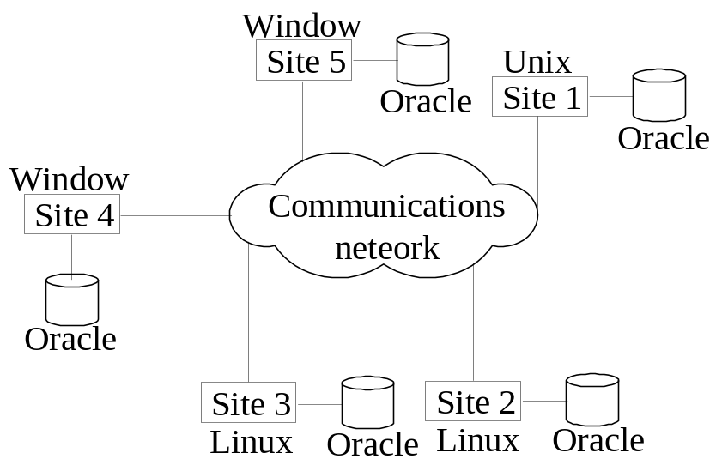
Homogeneous
  All sites of the database system have identical setup, i.e., same database system software. The underlying operating system may be different. For example, all sites run Oracle or DB2, or Sybase or some other database system. The underlying operating systems can be a mixture of Linux, Window, Unix, etc. The clients thus have to use identical client software.

Slide 28
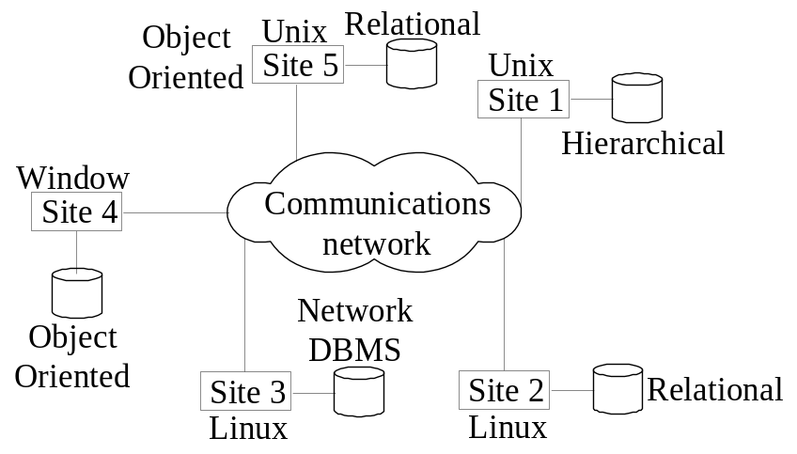
Heterogeneous
  Federated: Each site may run different database system but the data access is managed through a single conceptual schema. This implies that the degree of local autonomy is minimum. Each site must adhere to a centralized access policy. There may be a global schema.

Slide 29
Types of Distributed Database Systems
Factors that make DDS different
Degree of homogeneity
If all the servers use identical software and all the users use identical software.
Degree of local autonomy
If there is no provision for the local site to function as a stand-alone DBMS, then the system as no local autonomy.

Slide 30
cont…
Types of Distributed Database Systems
Centralized Database System
  No local autonomy exists.
Federated Distributed Database System
  Each server is an independent and autonomous centralized DBMS that has its own local users, local transaction, and DBA and hence has a very high degree of local autonomy.
  Used when there is some global view of databases shared by applications.

Slide 31
Federated Database Management Systems Issues
Differences in data models
  Deal with different data models via a single global schema or to process them in a single language is challenging.
Differences in constraints
  Constraint facilities for specification and implementation vary from system to system which should be dealt using global schema
Differences in languages
  Same data model but different languages could be used and their version may vary.

Slide 32
Semantic Heterogeneity
Occurs when there are differences in the meaning, interpretation, and intented use or related data.
  Design autonomy
  Refers to their freedom of choosing design patterns.
  Communication autonomy
  Refers to the ability to decide whether to communicate with another component DBS.
  Association Autonomy
  Ability to decide whether and how much to share its functionality and resources with the other component DBs.

Slide 33
Five-level schema architecture to support global applications in the FDBS
External Schema
External Schema
Federated schema
Export schema
Export schema
Component Schema
Local schema
Component

Slide 34
cont..
Five-level schema architecture to support global applications in the FDBS
Local schema: Is the conceptual schema of the component database.
Component schema: Derived by translating the local schema into canonical data model or common data model for the FDBS.
Export model: Represents the subset of a component schema that is available to the FDBS.
Federated schema: Is the global schema or view, which is the result of integrating all the shareable export schemas.
External schema: Schema for a user group or an application, as in the three-level schema architecture.

Slide 35
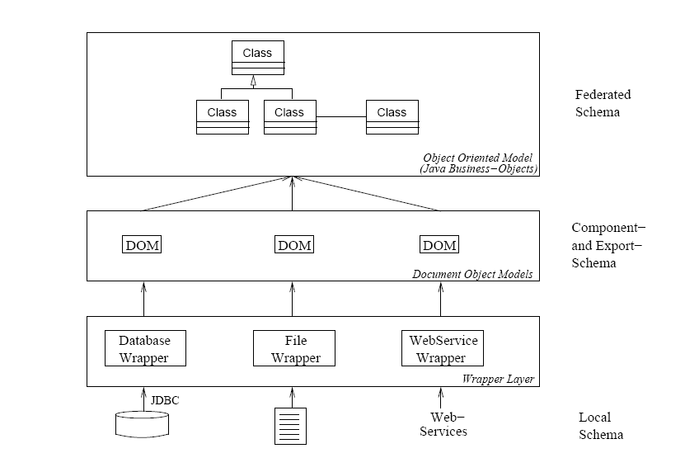

Slide 36
QUERY PROCESSING IN DISTRIBUTED DATABASES

Slide 37

Query Processing in Distributed Databases
Cost of transferring data (files and results) over the network.
This cost is usually high so some optimization is necessary.
Example relations: Employee at site 1 and Department at Site 2
Employee at site 1. 10, 000 rows. Row size = 100 bytes. Table size = 10⁶ bytes.
Fname | Minit | Lname | SSN | Bdate | Address | Sex | Salary | Superssn | Dno
Department at Site 2. 100 rows. Row size = 35 bytes. Table size = 3500 bytes.
Dname | Dnumber | Mgrssn | Mgrstartdate
Q: For each employee, retrieve employee name and department nameWhere the employee works.
Q: Π_{Fname,Lname,Dname} (Employee _{Dno = Dnumber} Department)

Slide 38
cont…
Query Processing In Distributed Databases
Factor which effects query processing
  The cost of transferring data over the network.
Goal of query processing
  The goal of reducing the amount of data transfer in choosing a distributed query execution strategy.
Eg : At site 1:
Employee
(Fname,Lname,SSN,Address,Superssn,Dno)
10,000 records each record is 100 bytes long
SSN field is 9 bytes long ,Fname field is 15bytes
Dno field is 4 bytes long, Lname field is 15 bytes long

Slide 39
cont…
Query Processing In Distributed Databases
Site 2:
Department
(Dname,Dnumber,MGRSSN,MGRSTARTDATE)
100 records
Each record is 35 bytes long
Dnumber field is 4 bytes long,Dname field is 10 bytes
MGRSSN field is 9 bytes long
Suppose you ask a query
Q: For each employee, retrieve employee name and department name Where the employee works.
Q: Π_{Fname,Lname,Dname} (Employee _{Dno = Dnumber} Department)

Slide 40
cont…
Query Processing In Distributed Databases
The result of this query will select 10,000 record assuming that
every employee is related to a department.
Each record in the query result will be of 40 bytes long.
This query is submitted at site 3 (result site)
There are three different strategies for executing this distributed query
1) Transfer both the employee and the department relations to the result site and form a join at site 3.In this case a total of 1,000,000+3500=1,003,500 bytes must be transferred .
2) Transfer the Employee to site 2, execute the join at site 2, and send the result to site 3.The size of the query is 40*10,000=400,000 bytes, so 400,000+1,000,000=1,400,000 bytes must be transferred.

Slide 41
cont…
Query Processing In Distributed Databases
3) Transfer the Department relation to site 1,execute the join at site 1 and send the result to site 3.un this case 400,000+3500=403,500 bytes must be transferred.
To minimize the amount of data transfer we should use the strategy 3.
So we should select the strategy for which the data transfer is minimum.

Slide 42
Distributed Query Processing Using Semijoin
Goal: To reduce the number of tuples in a relation before transferring it to another site.
Eg: For Q (previous query)
1) Project the join attributes of Department at site 2, and transfer them to site 1
F= Pro _{Dnumber} (Department) whose size is 4* 100=400 bytes.
2) Join the transferred file with the Employee
relation at site 1, and transfer the required attributes from resulting file to site 2. For Q, we transfer
R= Pro _{Dno,Fname,Lname} (F join _{Dnumber=Dno} Employee) whose
size is 39*100=3900 bytes.
3) Execute the query by joining the transferred file R with Department , and present the result at site 2.

Slide 43
Consider the query
Q’: For each department, retrieve the department name and the name of the department manager
Relational Algebra expression:
Π_{Fname,Lname,Dname} (Employee _{Mgrssn = SSN} Department)

Slide 44
Query Processing in Distributed Databases
The result of this query will have 100 tuples, assuming that every department has a manager, the execution strategies are:
Strategies:
Transfer Employee and Department to the result site and perorm the join at site 3. Total bytes transferred = 1,000,000 + 3500 = 1,003,500 bytes.
Transfer Employee to site 2, execute join at site 2 and send the result to site 3. Query result size = 40 * 100 = 4000 bytes. Total transfer size = 4000 + 1,000,000 = 1,004,000 bytes.
Transfer Department relation to site 1, execute join at site 1 and send the result to site 3. Total transfer size = 4000 + 3500 = 7500 bytes.

Slide 45
Query Processing in Distributed Databases
Preferred strategy: Chose strategy 3.
Now suppose the result site is 2. Possible strategies:
Possible strategies :
Transfer Employee relation to site 2, execute the query and present the result to the user at site 2. Total transfer size = 1,000,000 bytes for both queries Q and Q’.
Transfer Department relation to site 1, execute join at site 1 and send the result back to site 2. Total transfer size for Q = 400,000 + 3500 = 403,500 bytes and for Q’ = 4000 + 3500 = 7500 bytes.

Slide 46
cont.. Distributed Query Processing Using Semijoin
A semi join operation R Semijoin _{A=B} S where A and B are domain-compatible attributes of R and S, respectively, and produces the same result as the relational algebra expression Pro_{R} (Rjoin _{A=B} S).
In a distributed environment where R and S reside at different sites, the semijoin is typically implemented by first transferring F=Pro _{B} (S) to the site where R resides and then joining F with R.
Note that the semijoin operation is not commutative, that is
R semijoin S not equal to S semijoin R.

Slide 47
Semijoin Query Processing in Distributed Databases
Semijoin: Objective is to reduce the number of tuples in a relation before transferring it to another site.
Example execution of Q or Q’:
Project the join attributes of Department at site 2, and transfer them to site 1. For Q, 4 * 100 = 400 bytes are transferred and for Q’, 9 * 100 = 900 bytes are transferred.
Join the transferred file with the Employee relation at site 1, and transfer the required attributes from the resulting file to site 2. For Q, 34 * 10,000 = 340,000 bytes are transferred and for Q’, 39 * 100 = 3900 bytes are transferred.
Execute the query by joining the transferred file with Department and present the result to the user at site 2.

Slide 48
Query and Update Decomposition
The user must also maintain consistency of replicated data items when updating a DDBMS with no replication transparency.
The DDBMS supports full distribution, fragmentation and replication transparency and allows the user to specify a query or update request on the schema as though the DBMS were centralized.
For queries the query decomposition module must break up or decompose a query into subqueries that can be executed at the individual sites and combining the results of the subqueries to form the query result.

Slide 49
CONT…
Query and Update Decomposition
To determine which replicas include the data items referenced in a query, the DDBMS refers to the fragmentation, replication, and distribution information stored in the DDBMS catalog.
For vertical fragmentation the attribute list for each fragment is kept in catalog.
For horizontal fragmentation, a condition, some times called a guard, is kept for each fragment.
Guard is a selection condition which specifies which tuples exist in the fragment.

Slide 50
cont…
Query and Update Decomposition
Eg: A user requests to insert a new tuple
<‘Alex’, ‘B’, ,’Coleman’, ‘348889793’,’22-apr-64’, ‘3306 sandstone, houston, TX’, M,33000,’234412414’,4> would be decomposed into two insert requests.
The first insert inserts the preceding tuple in the Employee fragment at site1, and the second inserts the projected tuple
<‘Alex’, ’B’, ‘Coleman’, ‘348889793’, 33000, ’234412414’, 4> in the Empd4 fragment at site 3 for easy retrieval.
For query decomposition ,the DDBMS can determine which fragments may contain the required tuples by comparing the query condition with the guard conditions.

Slide 51
cont…
Query and Update Decomposition
Eg: Retrieve the names and hours per week for each employee who works on some project controlled by department 5.
SQL statement will be
Select Fname, Lname, Hours
From Employee , Project, Works_On
Where Dnum=5 and Pnumber = Pno and
ESSN=SSN.
Suppose that the query is submitted at site 2,where the query result is also needed. The DDBMS can determine from guard condition on Projs5 and Works_On5 that the tuple satisfy the condition (Dnum=5 and Pnumber=Pno)
where Projs5 is
attribute list: *(all attributes Pname, Pnumber,Plocation,Dnum)
guard condition: Dnum=5

Slide 52
cont…
Query and Update Decomposition
Works_On5
Attribute list:*(all attributes ESSN, PNO, HOURS)
Guard condition: ESSN IN (Proj _{SSN} (EMPD5)) OR PNO IN (Proj _{Pnumber}(Projs5)
Hence it may decompose the query into the following relational algebra subqueries:
T1<- Pro _{ESSN} (Projs5 Join _{Pnumber=Pno} Works_On5)
T2<-Pro _{ESSN,Fname,Lname}(T1 Join _{ESSN=SSN} Employee)
Result<- Pro _{Fname, Lname, Hours} (T2 * Work_On5)
This decomposition can be used to execute the query by using a semijoin strategy.

Slide 53
cont…
Query and Update Decomposition
The DDBMS knows from the guard condition that Projs5 contains exactly those tuples satisfy (Dnum=5) and works on contains all the tuples to be joined with Projs5,hence the subquery T1 can be executed at site2, and the projected columns ESSN can be sent to site 1.
Subquery T2 can then execute at site 1, and the result is sent back to site 2,where the final query result is calculated and displayed to the user.
An alternative strategy would be to send the query Q itself to site 1, which includes all the database tuples, where it would be executed locally and from which result would be sent back to site 2.
The query optimizer would estimate the costs of both strategies and would choose the one with the lower cost estimate.

Slide 54
OVERVIEW OF CONCURRENCY CONTROL

Slide 55
Overview Of Concurrency Control & Recovery in Distributed Databases
Distributed Databases encounter a number of concurrency control and recovery problems which are not present in centralized databases. Some of them are listed below.
These techniques are needed to deal with following problems ->
    Dealing with multiple copies of data items :- The concurrency control must maintain global consistency. Likewise the recovery mechanism must recover all copies and maintain consistency after recovery.
    Failure of individual sites :- Database availability must not be affected due to the failure of one or two sites and the recovery scheme must recover them before they are available for use.
    Failure of communication links :- This failure may create network partition which would affect database availability even though all database sites may be running.
    Distributed commit :- A transaction may be fragmented and they may be executed by a number of sites. This require a two or three-phase commit approach for transaction commit.
    Distributed deadlock :- Since transactions are processed at multiple sites, two or more sites may get involved in deadlock. This must be resolved in a distributed manner.
    .

Slide 56
Overview Of Concurrency Control & Recovery in Distributed Databases cont…
Concurrency Control Based on Distributed Copy of a Data Item
Terminology :-
    Distinguished Copy : particular copy of each data item, and the lock for this data item is associated with it.
Techniques :-
    Primary Site : The single Primary site is designated as Coordinator site for all dbase items. Hence, all Locking & Unlocking request are sent here.

Slide 57
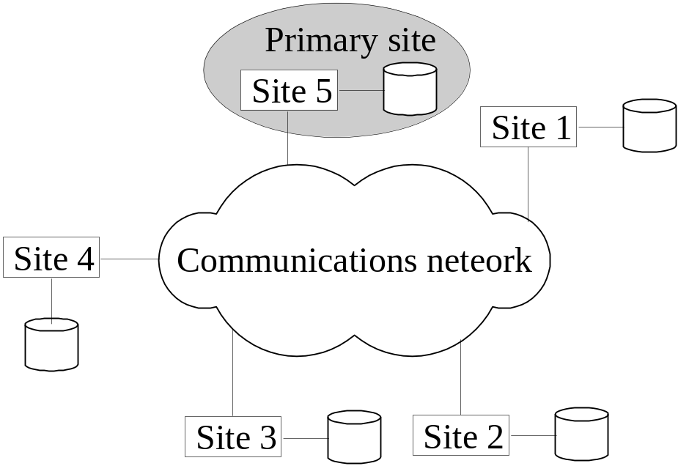
Concurrency Control and Recovery
Distributed Concurrency control based on a distributed copy of a data item
Primary site technique: A single site is designated as a primary site which serves as a coordinator for transaction management.

Slide 58
Concurrency Control and Recovery
Transaction management: Concurrency control and commit are managed by this site. In two phase locking, this site manages locking and releasing data items. If all transactions follow two-phase policy at all sites, then serializability is guaranteed.
Advantages: An extension to the centralized two phase locking so implementation and management is simple. Data items are locked only at one site but they can be accessed at any site.
Disadvantages: All transaction management activities go to primary site which is likely to overload the site. If the primary site fails, the entire system is inaccessible.
To aid recovery a backup site is designated which behaves as a shadow of primary site. In case of primary site failure, backup site can act as primary site.

Slide 59
Overview Of Concurrency Control & Recovery in Distributed Databases cont…
Concurrency Control Based on Distributed Copy of a Data Item
Techniques (cont..):-
    Primary Site with Backup Site : All locking information is maintained at both sites, in case, Primary site fails the Backup site takes over Primary site.
    Primary Copy : The distinguished copies of different data items stored at different sites.
    Choosing New Coordinator Site in Case of Failure: In case if coordinator fails, the sites which are running chooses new Coordinator

Slide 60
Concurrency Control and Recovery
Primary Copy Technique: This method attempts to distribute the load of lock coordination among various sites by having the distinguished copies of different data items stored at different sites.
Advantages: Since primary copies are distributed at various sites, a single site is not overloaded with locking and unlocking requests.
Disadvantages: Identification of a primary copy is complex. A distributed directory must be maintained, possibly at all sites.

Slide 61
Concurrency Control and Recovery
Recovery from a coordinator failure
In both approaches a coordinator site or copy may become unavailable. This will require the selection of a new coordinator.
Primary site approach with no backup site: Aborts and restarts all active transactions at all sites. Elects a new coordinator and initiates transaction processing.
Primary site approach with backup site: Suspends all active transactions, designates the backup site as the primary site and identifies a new back up site. Primary site receives all transaction management information to resume processing.
Primary and backup sites fail or no backup site: Use election process to select a new coordinator site.

Slide 62
Overview Of Concurrency Control & Recovery in Distributed Databases cont…
Concurrency Control Based on Voting
Voting Method
    There is no distinguished copy
    All sites includes a copy of data item, and also each maintains its own lock.
    When a transaction request lock ,then that request is sent to all sites, and it gets granted, when it is locked by majority of copies. And it informs all the copies that Lock has been granted .

Slide 63
Concurrency Control and Recovery
Concurrency control based on voting: There is no primary copy of coordinator.
Send lock request to sites that have data item.
If majority of sites grant lock then the requesting transaction gets the data item.
Locking information (grant or denied) is sent to all these sites.
To avoid unacceptably long wait, a time-out period is defined. If the requesting transaction does not get any vote information then the transaction is aborted.

Slide 64
Overview Of Concurrency Control & Recovery in Distributed Databases cont…
Distributed Recovery
Case I :When X sends message to Y , expects, response from Y, but Y fails.
  Possibility :-
    Message deliver fails because of Communication failure.
    Site Y is down.
    Response deliver fails.
Case II : When Transaction is updating at several sites, it cannot commit until it is sure that effect of transaction is on every site.

Slide 65
OVERVIEW OF 3-TIER CLIENT SERVER ARCHITECTURE

Slide 66
Overview of 3-Tier .
Client-Server Architecture
3-Tier Architecture
Presentation Layer :- This provides the user interface and interacts with the user. The programs at this layer present Web interfaces or forms to the client in order to interface with the application.
Application Layer :- This layer programs the application logic. The queries can be formulated based on user input from the client or query results can be formatted and sent to client for presentation.
Database Server :- This layer handles the query and update requests from the application layer, process the requests, and send the results. Usually SQL is used to access the database.

Slide 67
3-Tier Client-Server Database Architecture
The interaction between the three layers during the processing of an SQL query.
The presentation layer first takes an user input and displays the needed information to the user.
The application server formulates a user query based on input from the client layer and decomposes it into a number of independent site queries. Each site query is sent to appropriate database server site.
Each database server processes the local query and sends the results to the application server site.
The application server combines the results of the sub queries to produce the result of the originally required query, formats it into HTML or some other form accepted by the client, and sends it to the client site for display.

Slide 68
Distributed Database .
In ORACLE
In Client-Server Arch., Oracle dbase is divided into 2 parts
    Front-end as Client : It interacts with user. Its main purpose is to handle requesting, processing, and presentation of data managed by server.
    Back-end as Server : It runs Oracle and handles the functions related to concurrent shared access. And also process Client’s SQL & PL/SQL queries.
Oracle Client-Server Application provides location Transparency, making data transparent to users.

Slide 69
Distributed Database (cont..) In ORACLE
Oracle dbases in a distributed dbase systems use Oracle’s networking software Net8 for inter-database communication.
Oracles supports database links that define a one-way communication path from one Oracle database to another.
For eg :
CREATE DATABASE LINK sales.us.americas;
establishes a connection to the “sales” dbase, under n/w domain “us” that comes under domain “americas”.
Data in a Oracle DDBS can be replicated.
      Basic replication : Replicas of tables are managed for read-only access.
      Advanced replication : Allows to update table replica’s throughout a replicated DDBS. Thus, data can be read or updated a any site.

Slide 70
Distributed Database (cont..) In ORACLE
Heterogeneous DBASE in Oracle :
  Here at least one dbase is a non-Oracle System.
  Oracle Open Gateway provides access to a non-Oracle System.
  The features are :-
    Distributed Transactions
    Transparent SQL access
    Pass-through SQL & stored procedure
    Global Query optimization
    Procedure access

Slide 71
Distributed Databases in Oracle
In the client-server architecture, the oracle database system is divided into two parts
1) A front end client portion which
interacts with the user.
2) A back –end server portion runs
oracle and handles the functions
related to concurrent shared access.
Oracle client-server applications provide location transparency by making location of data transparent to users, several features like views, procedures are used to achieve this.
Oracle uses a two phase commit protocol to deal with concurrent distributed transactions.
a) The COMMIT statement triggers the two phase commit mechanism.
b) The RECO (recoverer) background process automatically resolves the
outcome of those distributed transactions in which the commit was interrupted.

Slide 72
Distributed Databases in Oracle
All oracle database in Distributed Database system uses Oracle’s Networking Software Net8 for interdatabase communication.
Oracle supports Database links that define a one-way communication path from one Oracle database to another. For example,
CREATE DATABASE LINK sales.us.americas;
Data in Oracle DDBS can be replicated using snapshots or replicated master tables. This can be provided at the following two levels.
1) Basic replication: Replicas of tables are managed for read-only access. For updates data must be
accessed at a single primary site.
2)Advanced replication: This allows application to update table replicas throughout a
replicated DDBS. Data can be read and updated at any site. This requires additional Software
called advanced replication option
A snapshot generates replicas by means of a query called the snapshot defining query, an example is shown below.
CREATE SNAPSHOT sales.orders AS
SELECT * FROM sales.orders@hq.us.americas;

Slide 73
.
A & Q

